Slide 1
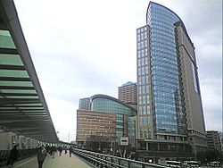
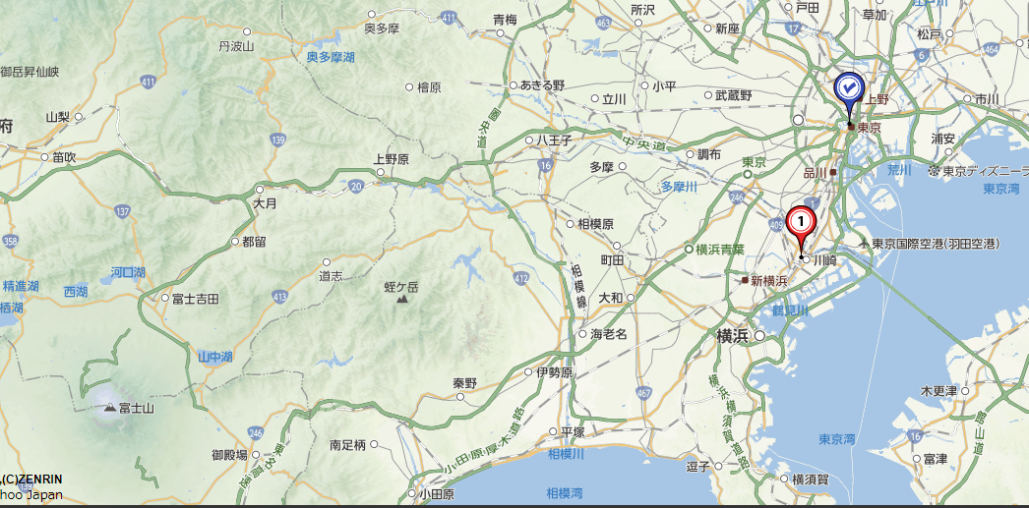
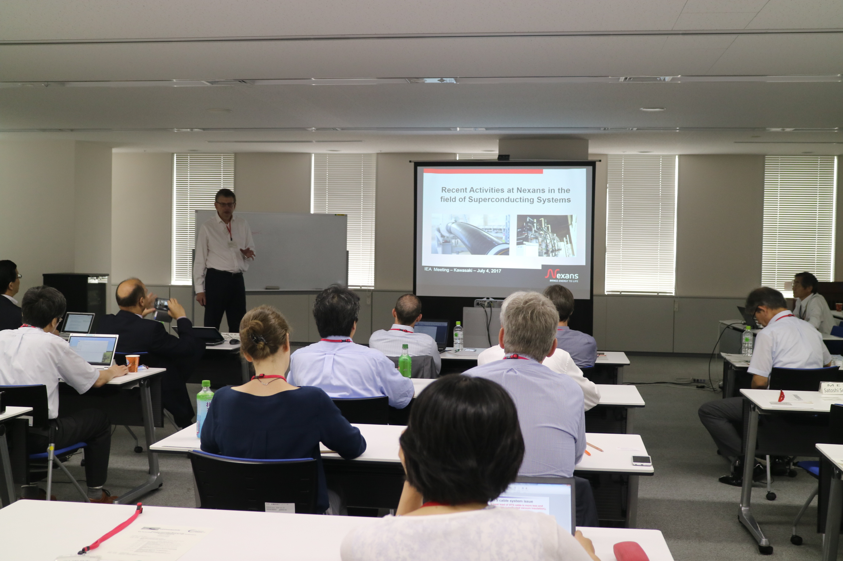
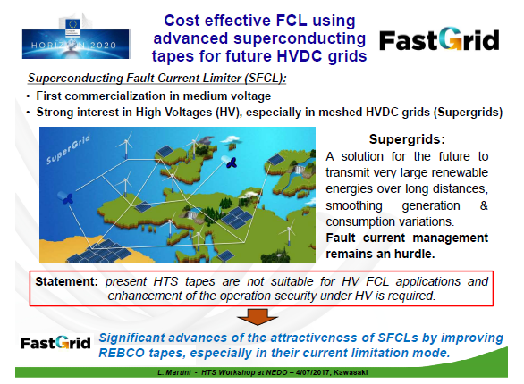

Report on last Exco in Japan (1)
Exco at EUCAS2017, Geneve, Sept. 20
Place: NEDO, Kawasaki, Japan, Date: July 3 -5, 2017
Tokyo
Kawasaki
Mt. Fuji
NEDO HQ (Kawasaki, Japan)
This time the meeting focused on Japanese (Host) activity and the HTS commercialization.
HTS Activity of member countries and discussion
Typical example: New EU project of SFCL
Guest presenter NEXANS, Jean-Maxime.Saugrain

Slide 2
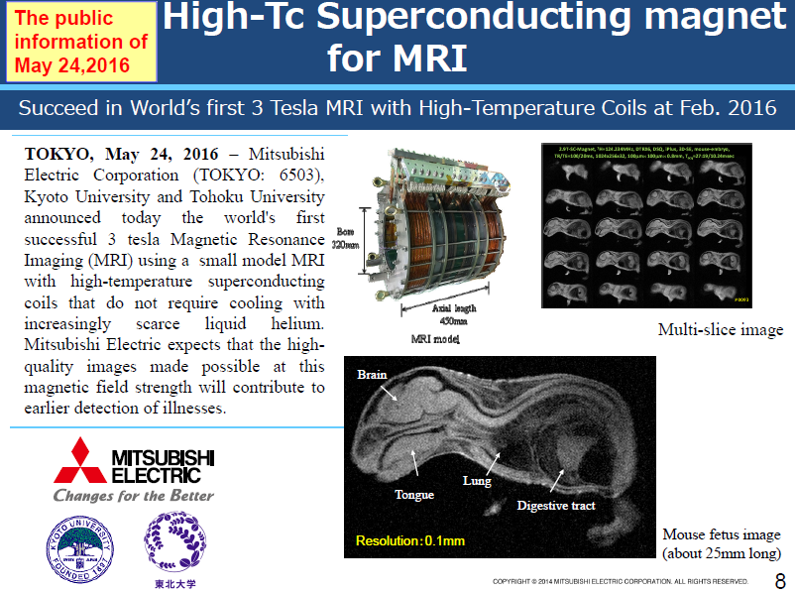
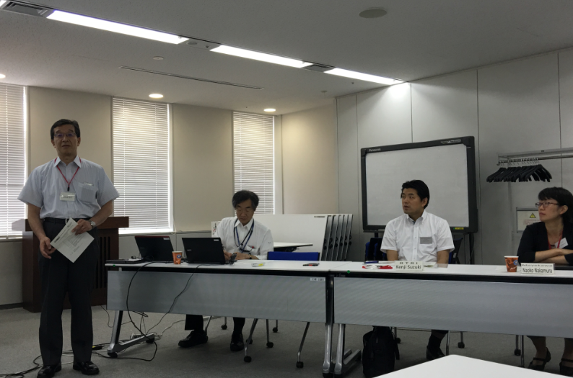
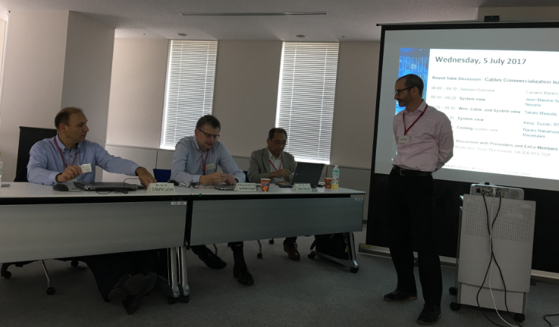
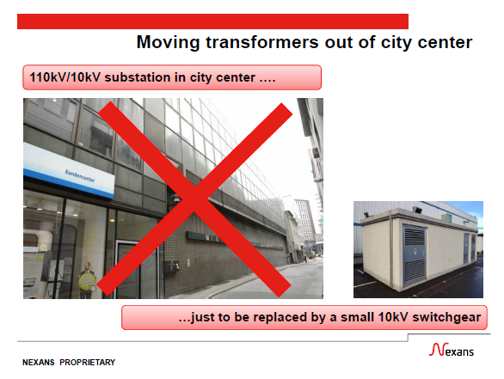
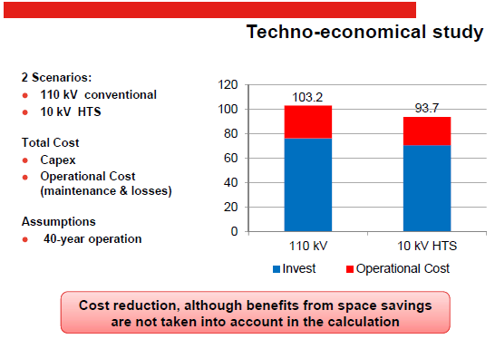
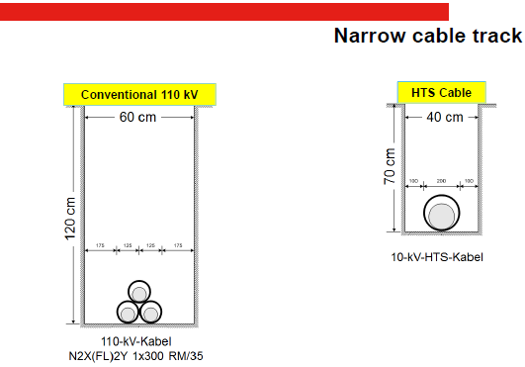
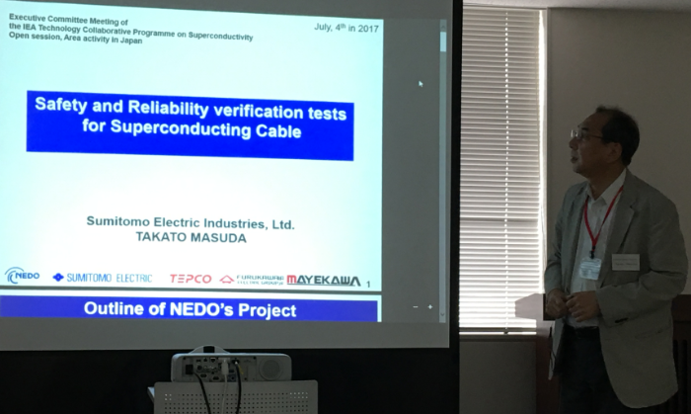
Report on last Exco in Japan (2)
Exco at EUCAS2017, Geneve, Sept. 20
Japanese Activity
NEDO HTS national project
SEI (Cable)
Railway Tech. Research Inst. (cable)
Mitsubishi Electric(MRI)
Fujikura (Wire)
Taiyo Nippon Sanso (TurboBrayton)
Round Table Discussion for HTS Cable commercialization
Merit of the HTS power cable conducted now
Discussion:
/Effect of HTS Cable /Issues for commercialization
Economics (Costs of wie, cooling sys.)
Reliability
Standardization and so on.

Slide 3
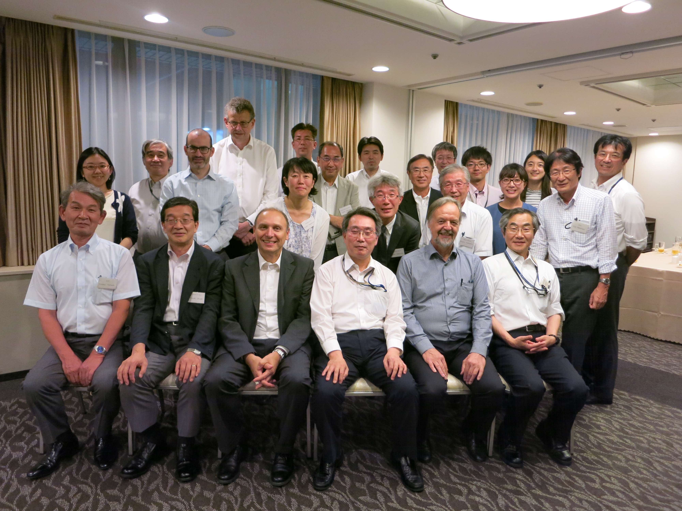
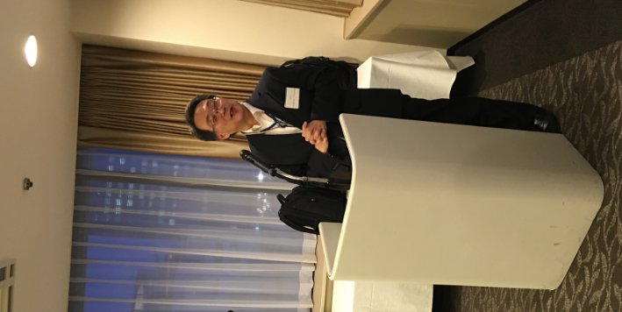
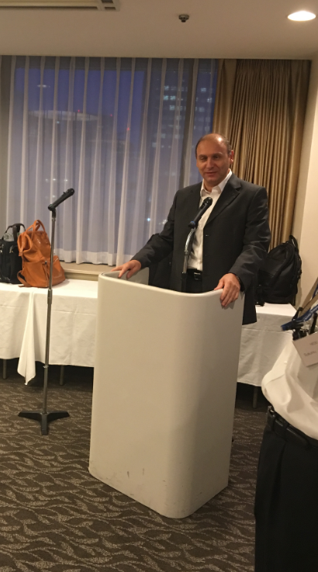
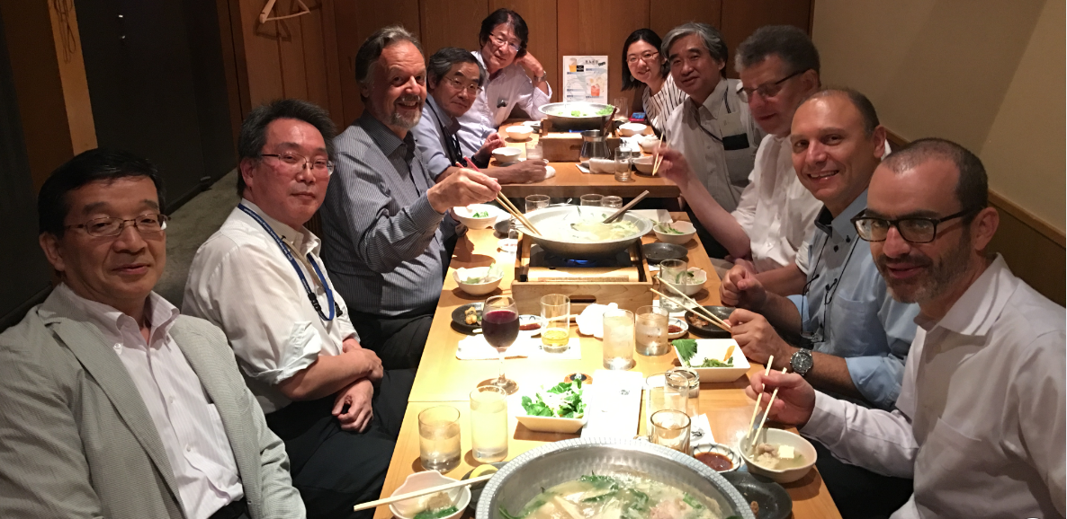
Report on last Exco (3): Extra data, Banquet
Exco at EUCAS2017, Geneve, Sept. 20
Host NEDO Director
Watanabe-san
2nd day Official Banquet at Nikko Kawasaki Hotel with Exco, NEDO, and Presenters
Luciano, Greeting
1st day Dinner with members at Typical Japanese Restaurant.

Slide 4
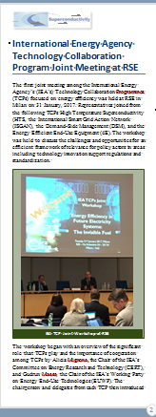
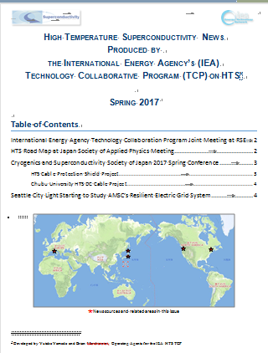
HTS-News and Trend (Journal)
Exco at EUCAS2017, Geneve, Sept. 20
Object and Contents
Latest Article
-TCP cooperation at Exco in Milan,RSE-
/Hot news and trend /Focused mainly on Electric Power Applications Cable, Current Limiter, Motor, Generator ….
/National project and Governmental Funding Trend
Quarterly issued (Spring, Summer, Fall, Winter).
World-wide news are selected for the executives, high level technology leaders for their guideline.

Slide 5
HTS-News and Trend (Journal)
Exco at EUCAS2017, Geneve, Sept. 20
Next issue will includes
Exco in Japan
EUCAS
IWC-HTS at KIT
China ASC
other topics in each area

